Slide 1
We love Our Beavers!
Erhard Kraus
39 Shellamwood Trail
416-293-3755

Slide 2
Let’s Keep the Agincourt Beavers in their New Home
The beavers have made a new home in Agincourt
Beavers are great for the Neighbourhood
A few things need to be done to keep them here

Slide 3
We Benefit From Our Beavers
A natural park that enhances the enjoyment of our neighbourhood
An educational opportunity for children and newcomers to Canada
It attests to the improved water quality of our streams
The beavers attract other wildlife that rounds out a natural environment
New park gives Ward 41 a bit of “cachet” amongst other wards – and will increase value of homes

Slide 4
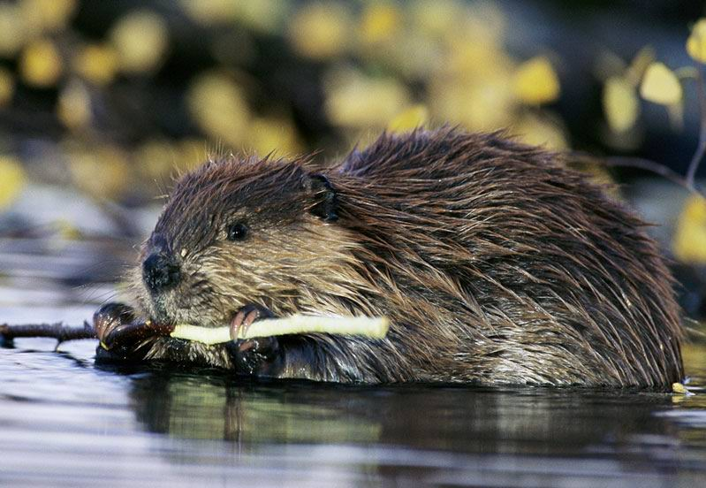
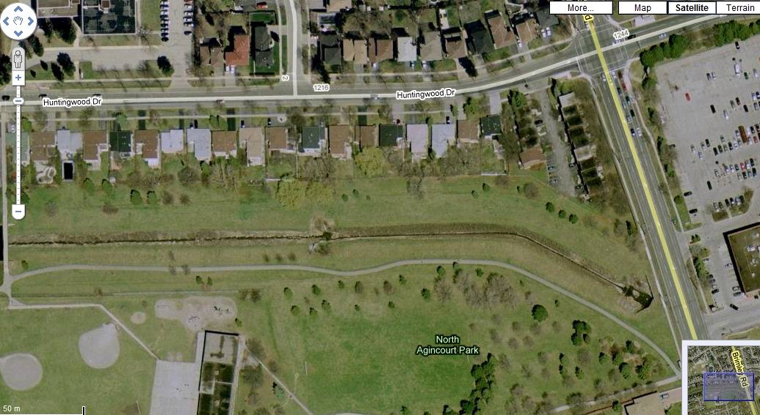
Where in Agincourt
In Ward 41, between Midland and Brimley south of Huntingwood

Slide 5
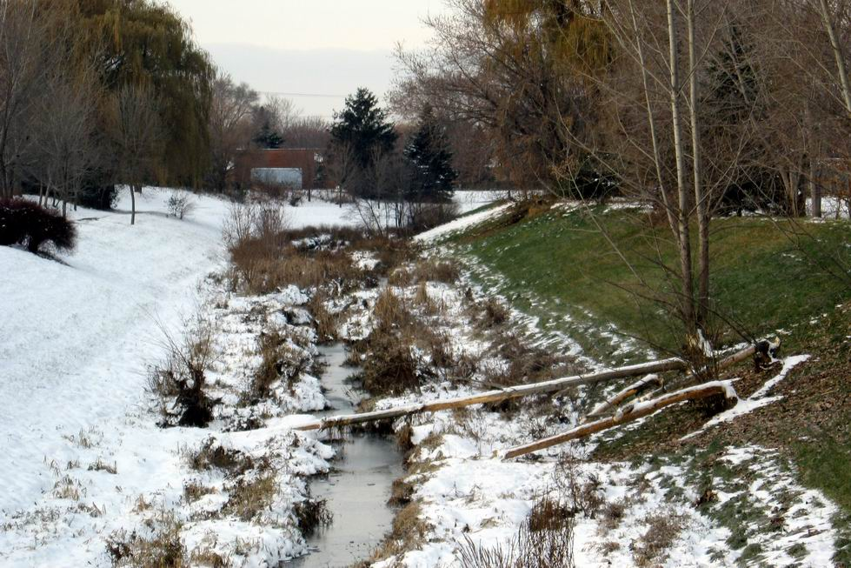
The drainage before Beaver
Photo taken last November, as the beaver settled in

Slide 6
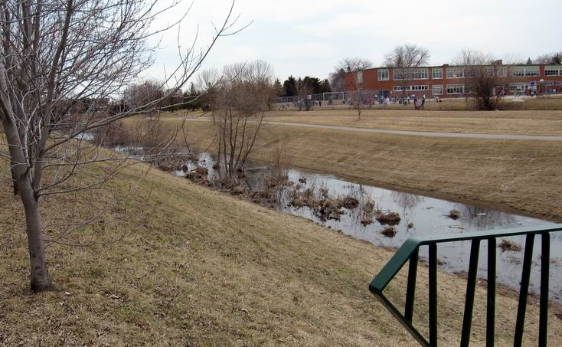
The Beaver’s New Home
The neighbourhood with its new pond

Slide 7
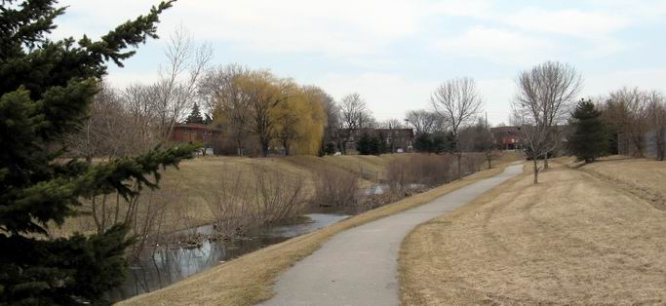
The pond
The pleasant walk beside the new pond

Slide 8
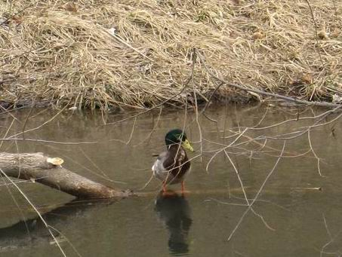
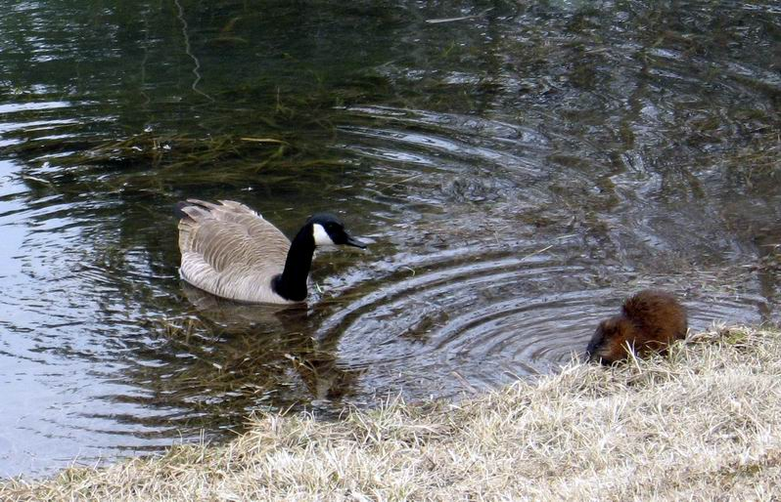
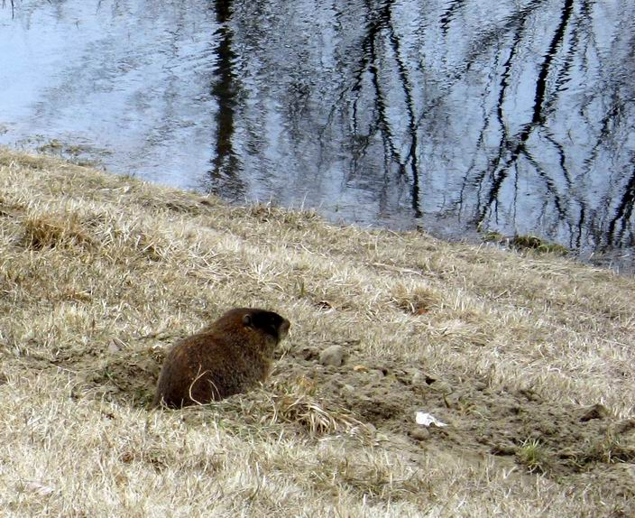
A new park was created
Ducks, geese and
a northern muskrat have joined

Slide 9
What happened so far
Our Beavers timeline
  They appeared in November 2008
  Survived the winter just fine
  Other wildlife has joined
  They promise to flourish at least one more year

Slide 10
What’s a Beaver’s Life like?
Eats bark and vegetation
Builds a dam to create a pond
Builds a lodge for safety, comfort and for winter
Keeps a food stash
Will move on if food is exhausted

Slide 11
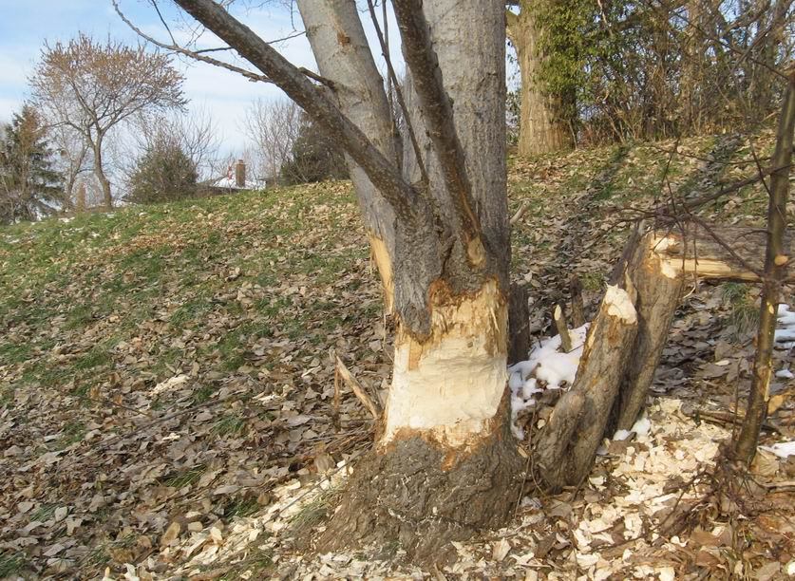
Eats bark and vegetation
Beavers will cut down unprotected bushes and trees
  Remedy:
  place wire mesh
  around trees
  to be kept

Slide 12
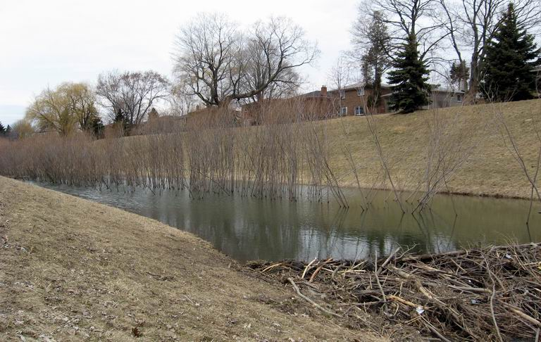
Builds a dam
Builds a dam to create a pond

Slide 13
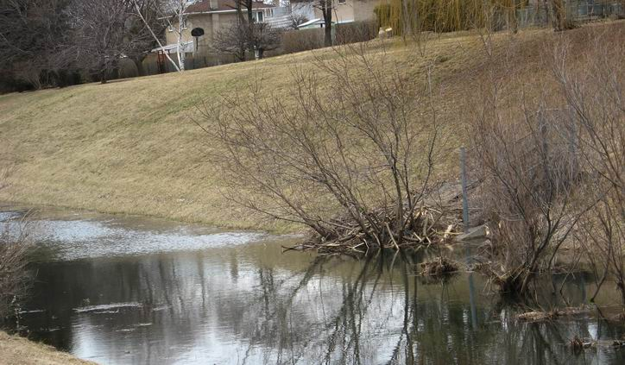
Builds a lodge
Builds a lodge for safety, comfort and for winter

Slide 14
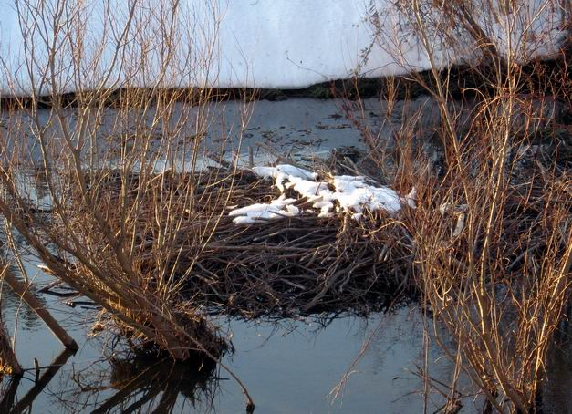
Keeps a food stash
Beavers collect food in fall and keep it as a food raft for winter

Slide 15
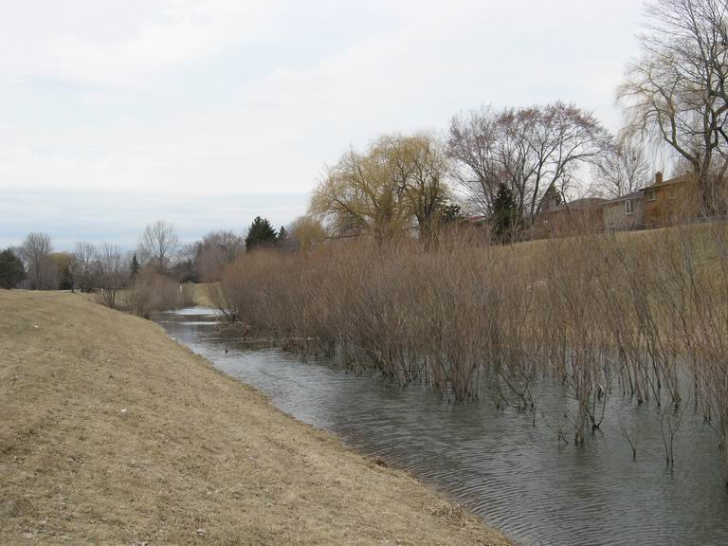
Beavers will move on if food is exhausted
Beavers stay within about 100m of their pond
If the food supply
gets low, they
move on

Slide 16
How to Keep Our Beavers
Protect City’s Trees from beavers’ appetite
Bring Schools on Board
Advise Neighbours of benefits and ways to protect their trees
Ensure food supply for long term
Bring city departments on board to ensure a successful future

Slide 17
We Love Our Beavers
For questions or just to talk, contact
Erhard Kraus
39 Shellamwood Trail
416-293-3755
erhard.interlog@gmail.com

